Slide 1
Requirements Definition Document and Use Cases
Note Taking Website
Soham Adhikary, Wentao Chen, Kimberly Ho, Kristen Jones, Paul Rajapandi, Catherine Vargas
Deliverable 2: IS 436 - 01

Slide 2
Requirement Definitions
Functional Requirements

Slide 3
Process - Oriented
The system must allow the registered user to retrieve their notes.
The system should allow users to store notes.
The system should allow users to label the notes.
The system should allow users to view the notes that they have stored.
The system sends an approval request after the user uploads their notes.

Slide 4
Information - Oriented
The system must retain the user's label and notes permanently.
The system must include real-time inventory levels.
The system must include the total number of notes for the current day.
The website pages should load in 3 seconds with the total number of simultaneous users <500.

Slide 5
Requirement Definitions
Non - Functional Requirements

Slide 6
Operational
The system will run on different kinds of end devices.
The system should be compatible with any Web browser.
The system should be responsive to the mobile device.
The system should be able to integrate with the existing inventory system.

Slide 7
Performance
Any interaction between the user and the system should not exceed 2 seconds.
The system should be available 24 hours per day, 365 days per year.
The system supports 100 simultaneous users from 9-11 am; 85 simultaneous users at all other times.

Slide 8
Security
Cultural/Political
The system should be able to distinguish between US currency and currency from other nations.
Country managers are permitted to authorize custom user interfaces within their units
Personal information is protected in compliance with the data protection act.
Only direct managers can see staff personnel records.
Technicians can see only their own work assignments.
Only the customers themselves or the ones that are given permissions can view the content of their notes.
The system includes all available safeguards from viruses, worms, trojan horses, etc.

Slide 9
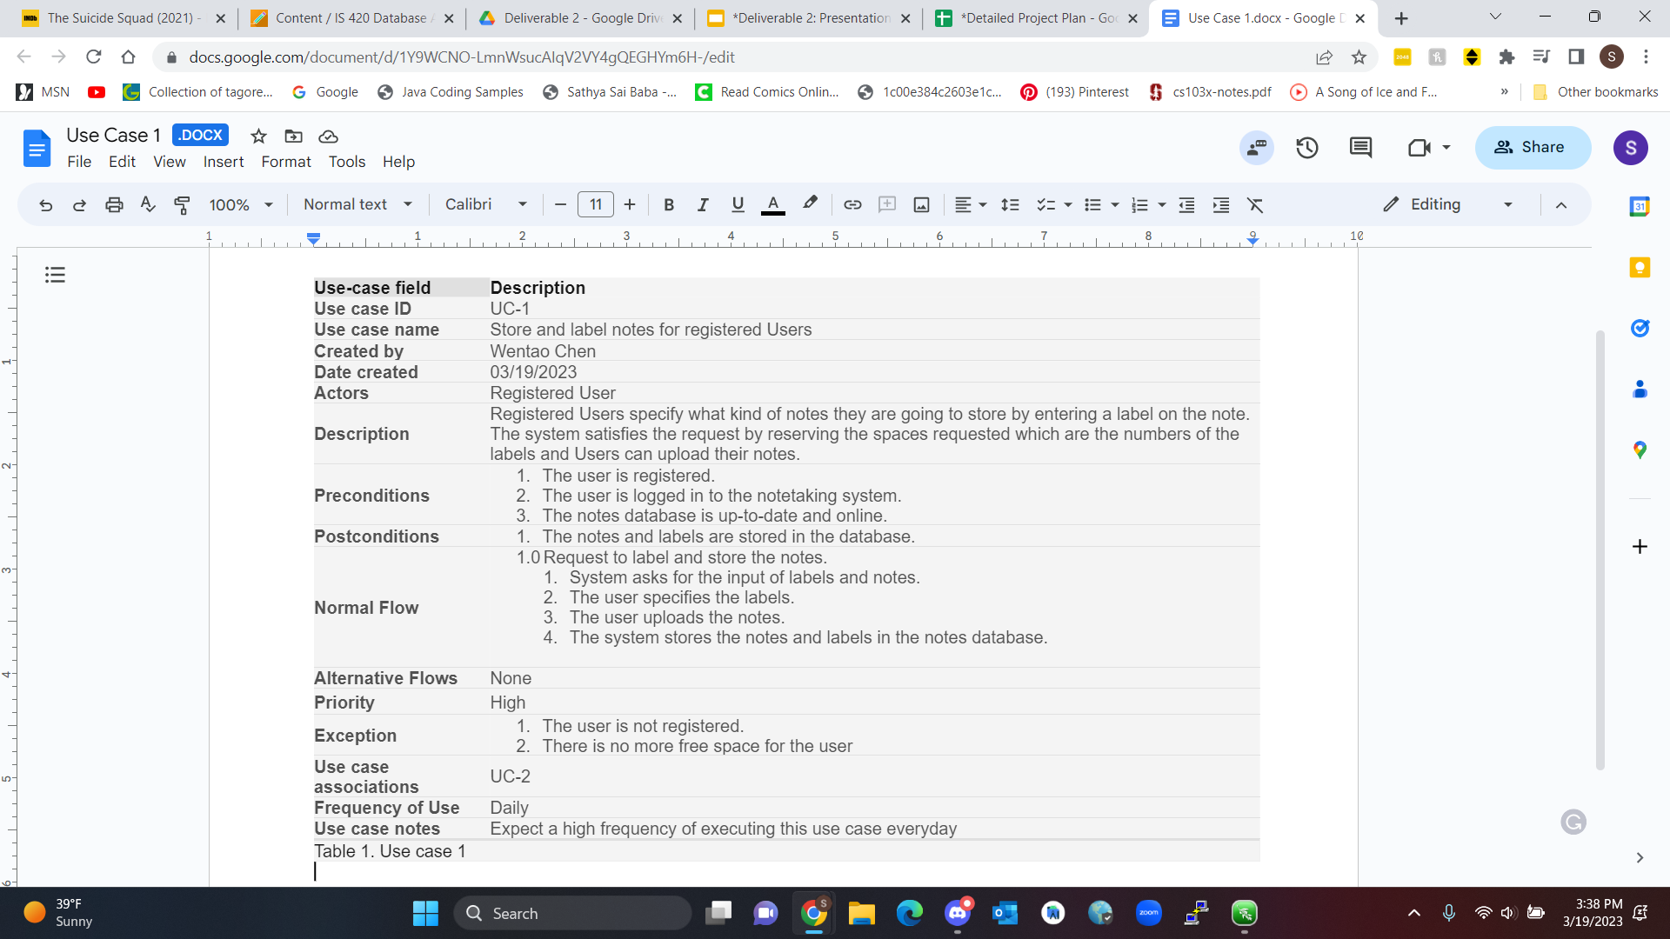
Use Case - 1

Slide 10
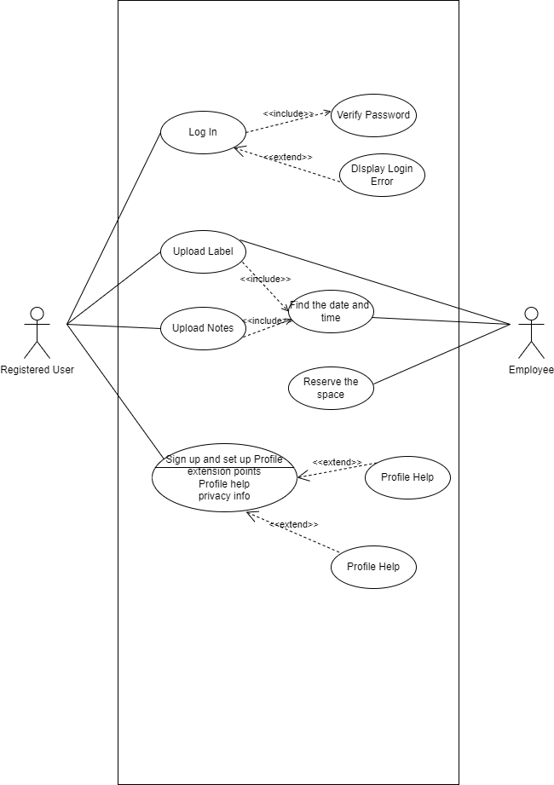
Use Case 1 - Diagram

Slide 11
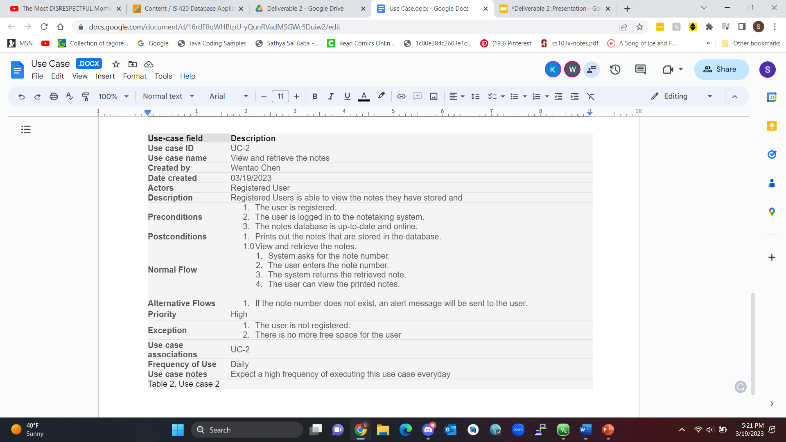
Use Case - 2

Slide 12
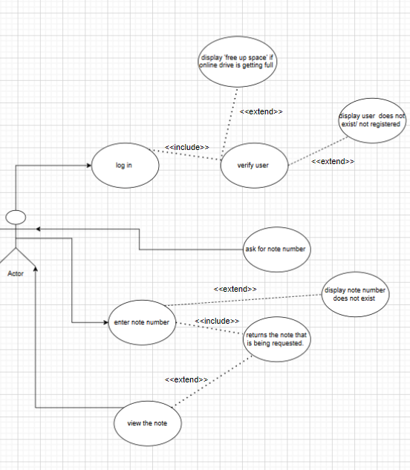
Use Case 2 - Diagram

Slide 13
Interview Information
Online Note Taking Questionnaire -
https://forms.gle/38nnHoJzkk9ytN3G

Slide 14
Survey Analytics
Distribution Method
Online Forums and internally via email
Response rate:
6% for email surveys, 8% for website surveys

Slide 15
Interview Questions
Do you prefer to take notes electronically, written, or both? Please explain.
How are you most likely to access electronic notes? Ie. Website, Apps, Laptop or PC, Mobile Device.
What note taking apps or sites have you used and which one do you like most and why? Ie. Microsoft OneNote, Default Device Notes, Notion, etc.
What is your favorite thing about using those apps or taking notes traditionally?
What features do you wish were included in note taking applications websites?
Is there any other feedback you’d like to share?

Slide 16
Purpose of Interview:
To understand why potential customers use competitor systems
To understand positive points of current competitor systems
To learn improvements needed to current note taking systems customers wish were included
To understand what customers want out of our future systems
To incorporate the positives of both written and electronic notes into a system

Slide 17
Interviewee: America Mathews
Position of Interviewee: Student and Employed
Title: Chemistry Major, Retail Worker
Interviewer: Kimberly Ho
Date: 3/12/2023
Time: 12:05:23
Summary
Interviewee previously used Note apps:
Microsoft OneNote
Default Device notes
Notion
EverNote
They express that Electronic notes
Does not waste paper like traditional methods
Easily able to turn into PDF
Unlimited space and word count
Different pen options and colors
They wish to be able to
Create custom brushes
Easy to access scribble tool for text, shapes, and math functions
Dislike:
Paying for unnecessary subscriptions
Ie. paying for more note pages

Slide 18
Interviewee: Sarah Prasons
Position of Interviewee: Employed
Title: IT Specialist
Interviewer: Kimberly Ho
Date: 3/13/2023
Time: 10:56:26
Summary
Interviewee previously used Note apps:
Microsoft OneNote
Default Device note
They express that they prefer traditional note writing
Company provides Microsoft accounts
Coworkers can easily share notes
Everything in one spot
They wish to be able to
More easily create graphs
Have an included ruler, protractor,
and calculator

Slide 19
Interviewee: Jamiya Lindsey
Position of Interviewee: Employed
Title: English Teacher
Interviewer: Kimberly Ho
Date: 3/14/2023
Time: 19:23:54
Summary
Interviewee previously used Note apps:
Microsoft OneNote
Default Device notes
Google Drive
School provides a Microsoft account
Able to create to-do lists
Easily able to edit
They wish to be able to
Access their notes across all platforms
and devices

Slide 20
Interviewee: Tyrell Jones
Position of Interviewee: Student
Title: Music Major
Interviewer: Kimberly Ho
Date: 3/17/2023
Time: 10:37:05
Summary
Interviewee previously used Note apps:
Default Device notes
They express default device notes
Easy to use; simple
Versatile
Keeps everything in one spot
They wish to be able to
Access a free service that
provides music sheet notes

Slide 21
Interviewee: Lauren Jones
Position of Interviewee: Student
Title: Statistics Major
Interviewer: Kimberly Ho
Date: 3/18/2023
Time: 6:21:04
Summary
Interviewee previously used Note apps:
Microsoft OneNote
Default Device notes
Notion
They express that Notion is
Easy to use
Easily able to create a todo list
Create charts and diagrams
They wish to be able to
Record or add audio
Add notes to audios.

Slide 22
Overall Observation Notes
Apps and sites are quick and easy to access
Infinite pages or multiple pages with any number word count.
Support the import and export of PDFs
Multiple pen shape and color options
The ability to create charts, diagrams, drawings, and to-do lists
The ability to add images, videos, tables, and files
The standard for note taking services:
Premium features that interviewees have expressed interest in:
More specialized notes for different subjects Ie. Music sheets
The ability to record and add audio with the addition of adding notes to audio features
Additional math functions like rulers, protractors, and calculators
Custom brushes and colors
An app or website that can be easily accessible across all platforms

Slide 23
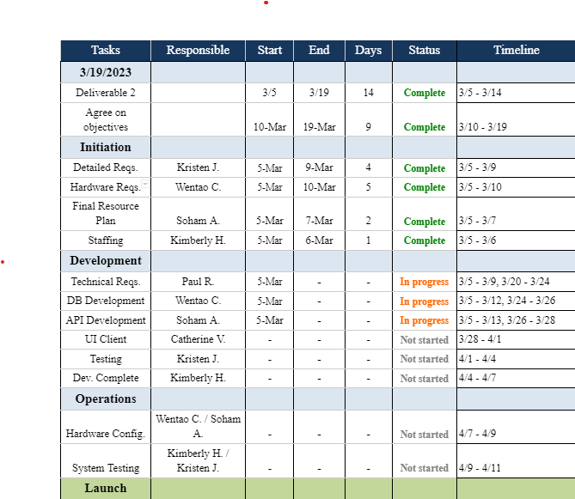
Detailed Project Plan
Start Date: 6 - Feb
End Date: 8 - May
OVerall Progress: 20%

Slide 24
Team Roles
Soham Adhikary
Kimberly Ho
Wentao Chen
Research Analyst
Data Analyst
Project Manager
Case Manager
Business Analyst
Catherine Vargas
Paul Rajapandi
Kristen Jones
Team Member
Team Member
Project Management

Slide 25
Contact Information
Soham Adhikary :
Wentao Chen :
Kimberly Ho :
Kristen Jones :
Paul Rajapandi :
Catherine Vargas :
sadhika2@umbc.edu
wentaochen@umbc.edu
kho6@umbc.edu
kjones24@umbc.edu
gauthar1@umbc.edu
cvargas1@umbc.edu

Slide 26
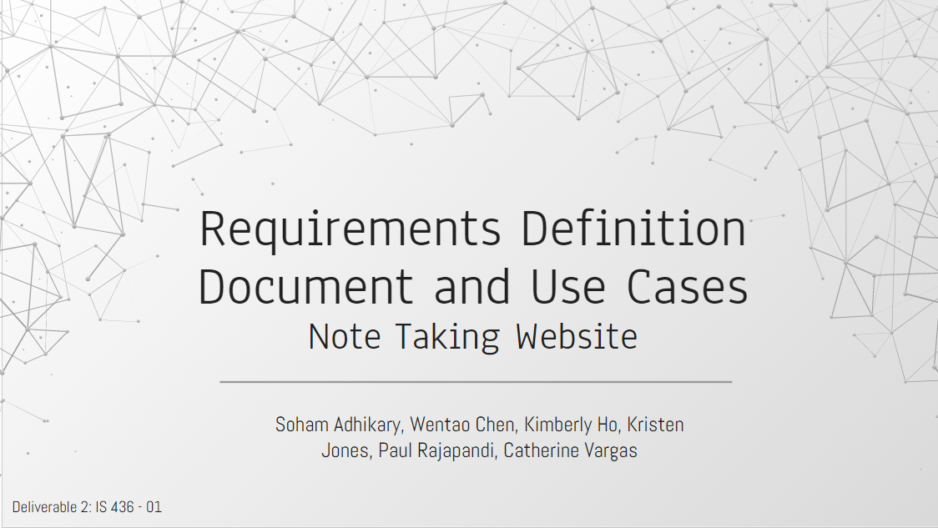
Thank
https://github.com/WentaoChen1/IS-436
You

